Slide 1
Agenda – 9/30
Welcome
Q&A – Assignments 3 and 4
Lecture – Wireless LANs (Chapters 6 & 7)
Quiz # 3 (Chapters 4 and 5)
Lecture – Wireless LANs Cont’d
Next Week – Assignment 5 due, Quiz 4

Slide 2
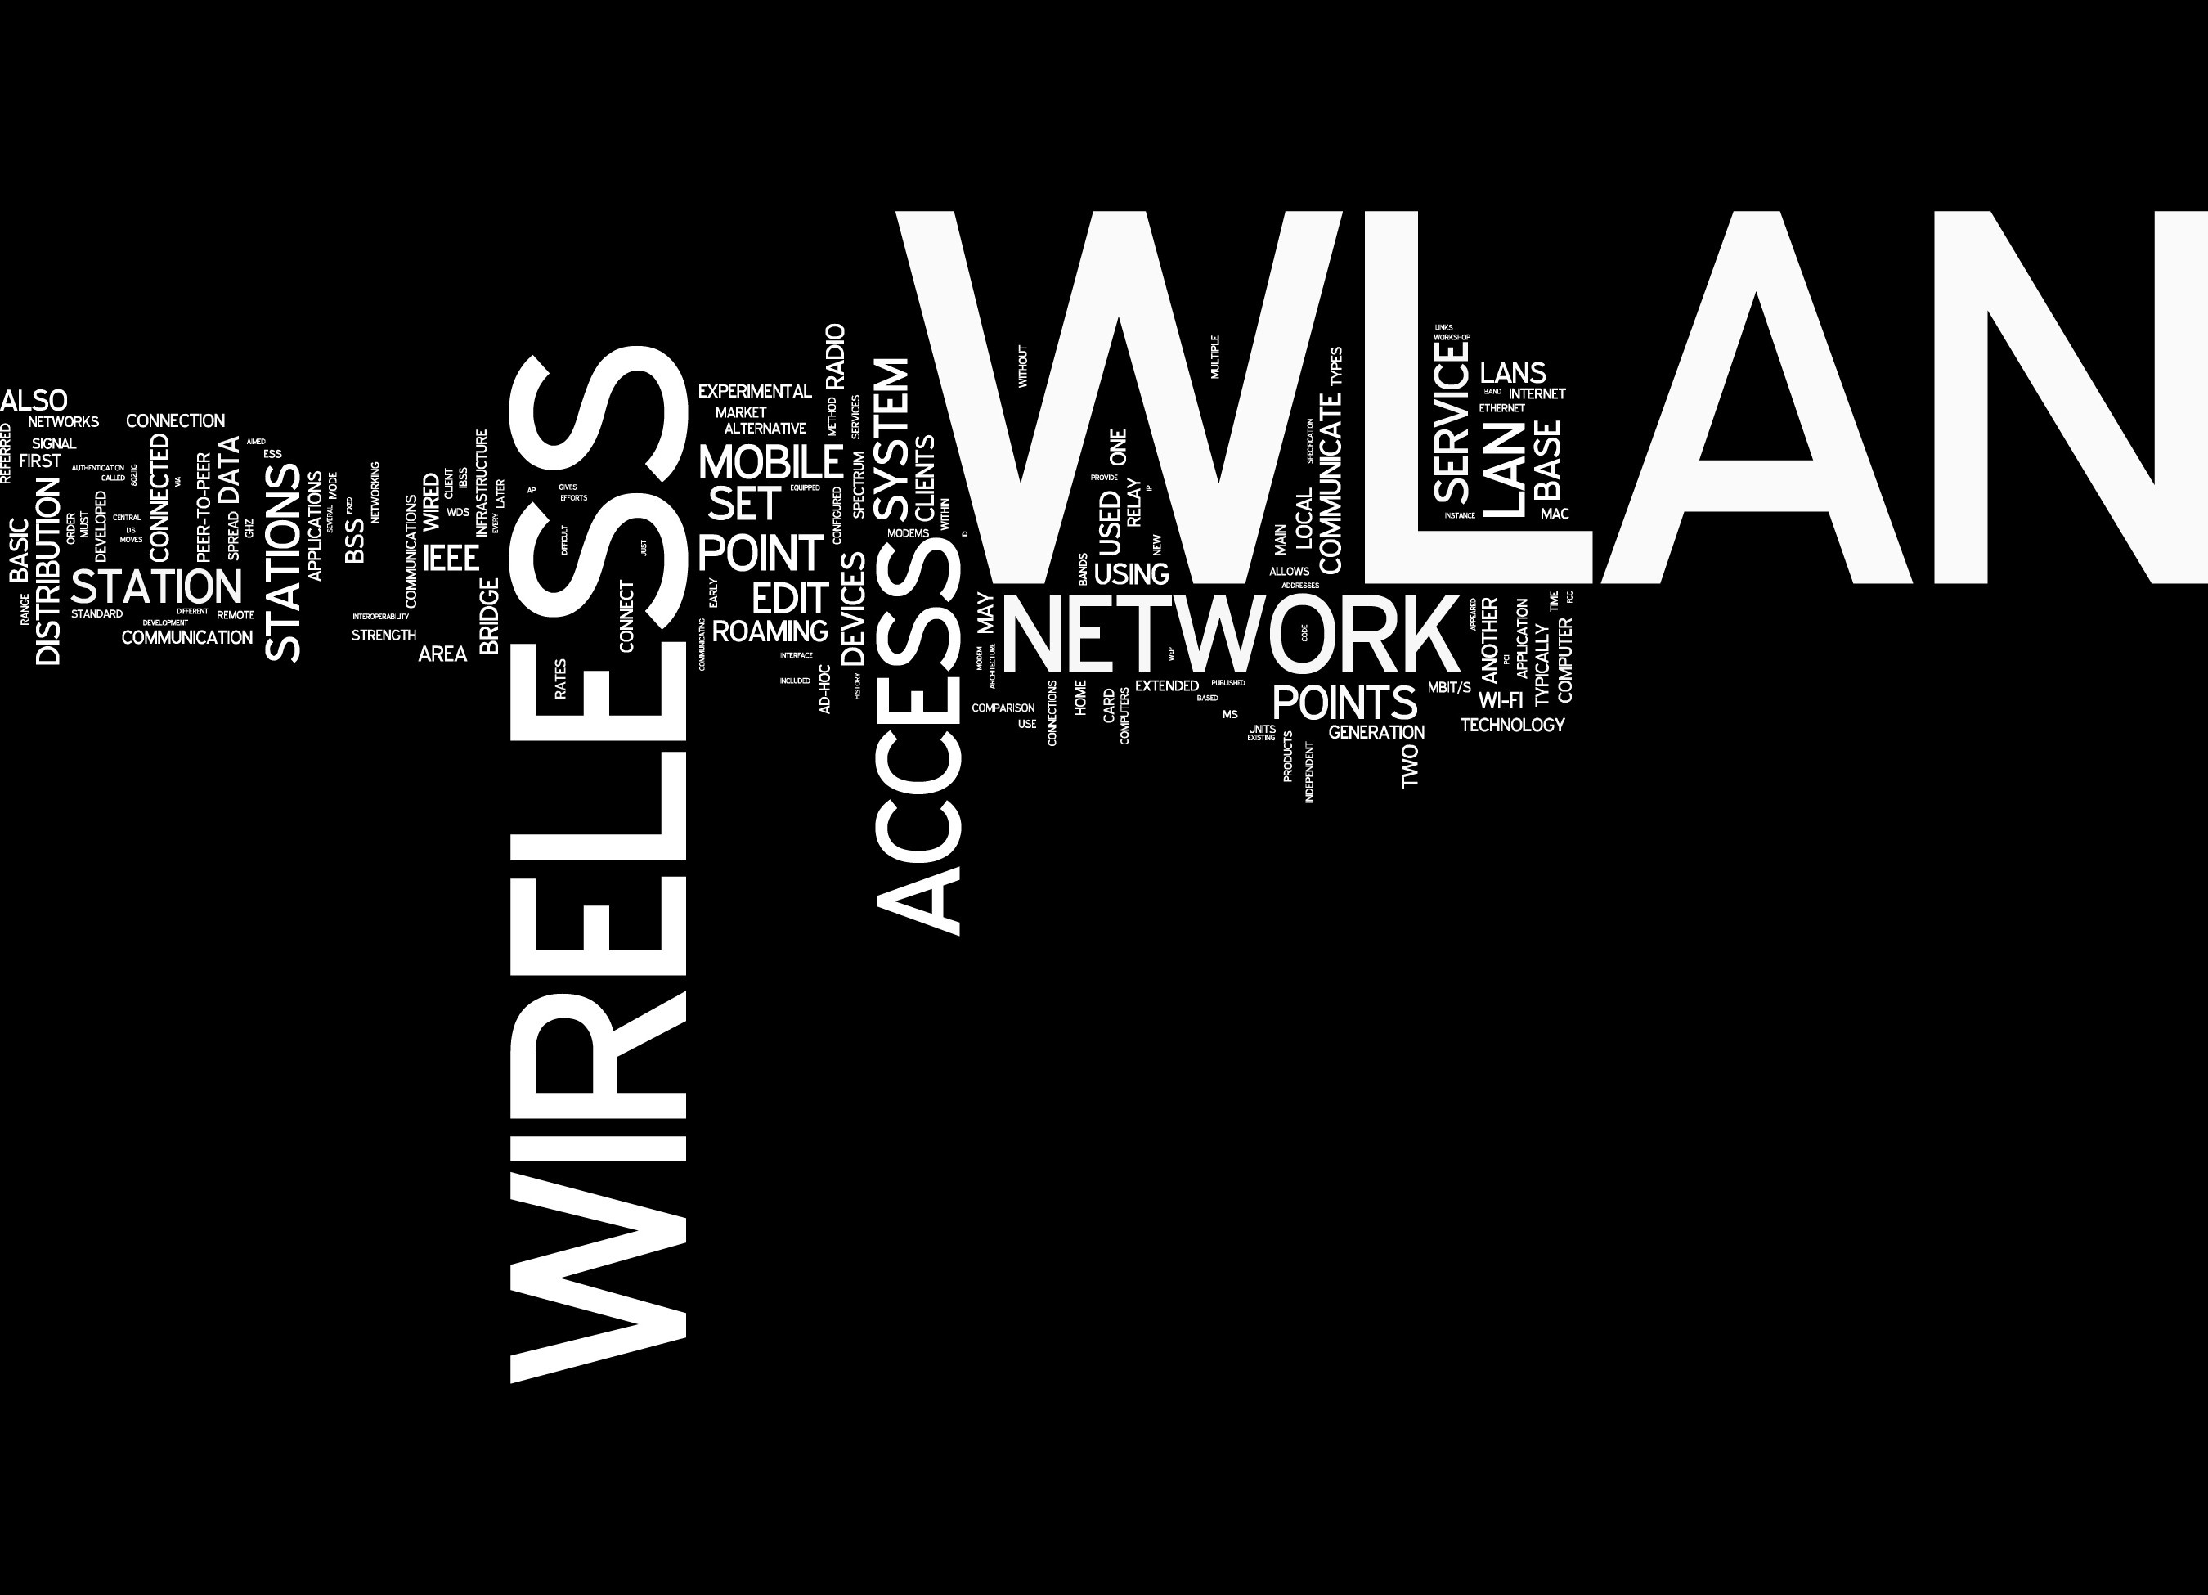
Wireless LANs I
Chapter 6
Panko and Panko
Business Data Networks and Security, 9th Edition
© 2013 Pearson

Slide 3
6.1: 802.11 Wireless LAN Technology
802.11 is the dominant wireless LAN (WLAN) Technology
Standardized by the 802.11 Working Group
Large 802.11 WLANs use multiple access points to cover large areas
802.11

Slide 4
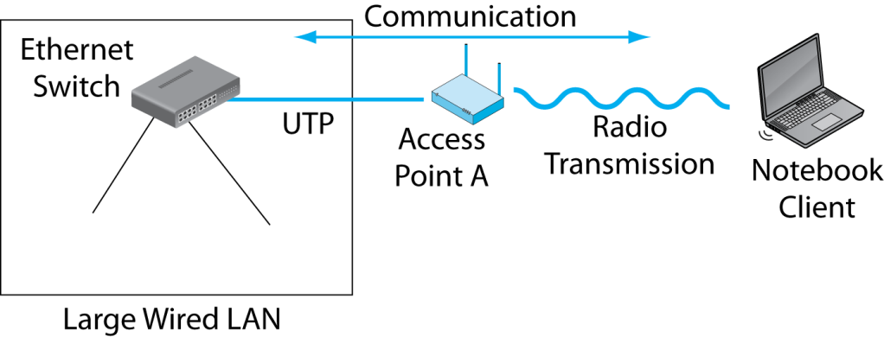
6.2: 802.11 Wireless LAN (WLAN) Operation
The wireless access point connects the wireless client to the wired Ethernet LAN.

Slide 5

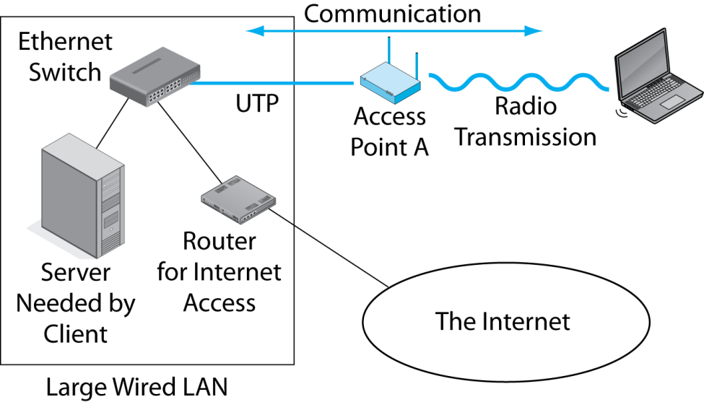
6.2: 802.11 Wireless LAN (WLAN) Operation
The LAN connection is needed to give clients access to servers and Internet access routers on the wired LAN.

Slide 6
6.2: 802.11 Wireless LAN (WLAN) Standards
Speeds and Distances to Devices
Speeds up to 300 Mbps, but usually 10 to 100 Mbps
Distances of 30 to 100 meters

Slide 7
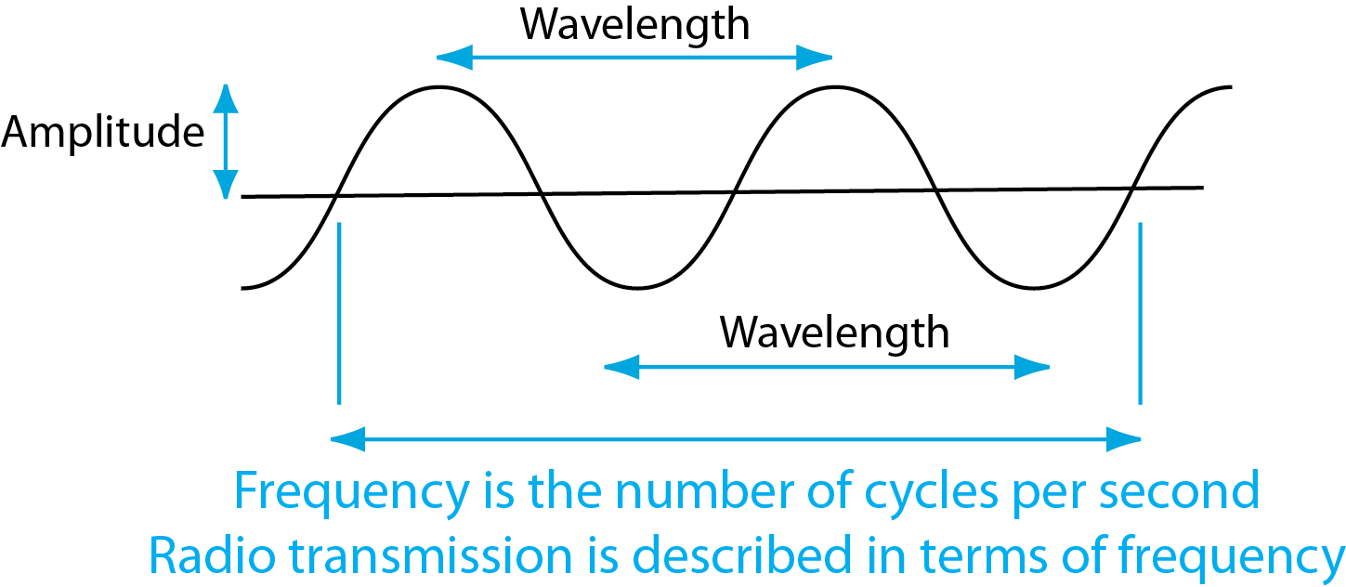
6.3: Electromagnetic Wave
Optical fiber transmission is measured in terms of wavelength.
Typical data LAN frequencies are 500 MHz to 10 GHz

Slide 8
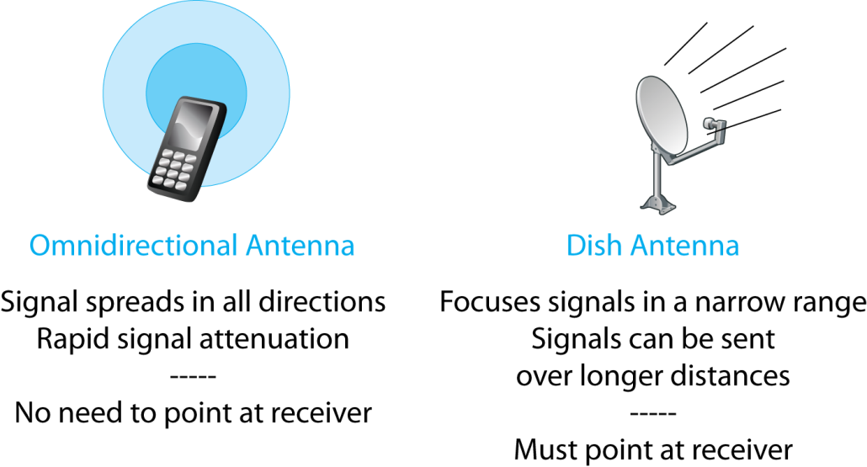
6.4: Omnidirectional and Dish Antennas

Slide 9
6.4: Omnidirectional and Dish Antennas
Questions:
What type of antenna do mobile phones use?
Why?

Slide 10
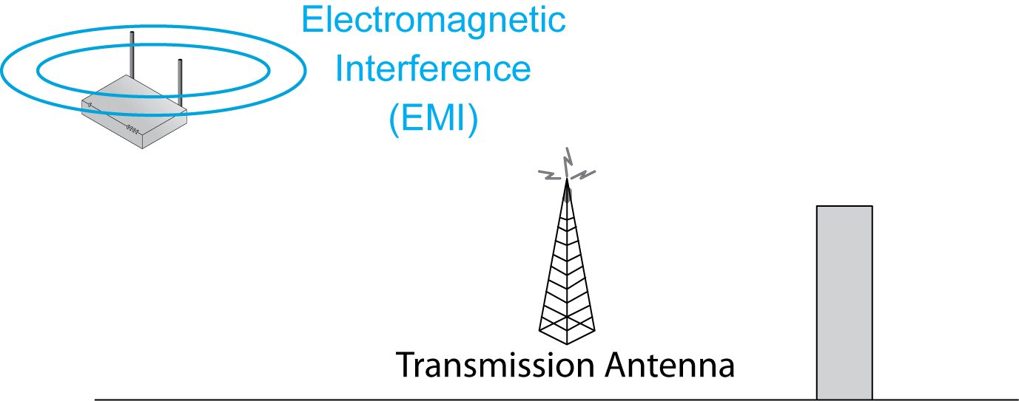
6.5: Wireless Propagation Problems
2.
Electromagnetic
Interference (EMI) is unwanted power at the same frequency from other devices.
1.
Wireless transmission has many propagation problems.

Slide 11
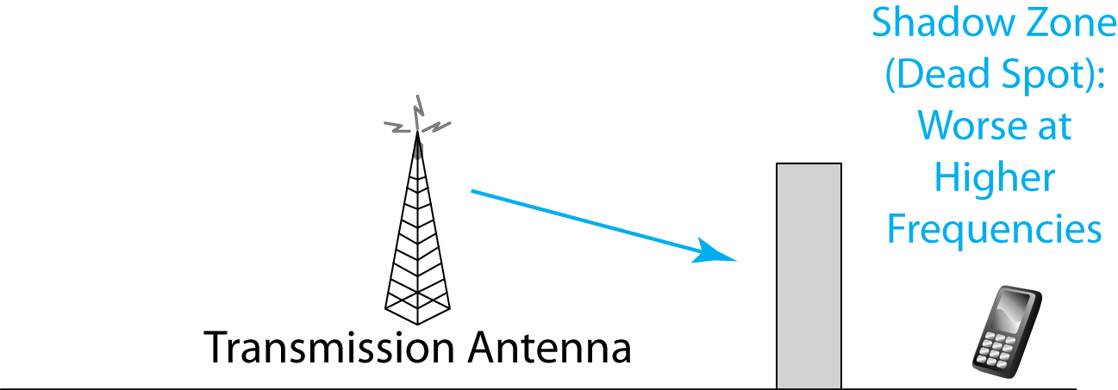
6.5: Wireless Propagation Problems
Shadow zones are places the signal cannot penetrate because of obstacles in its path.
Shadow zones, also called dead spots, grow worse as frequency increases.

Slide 12

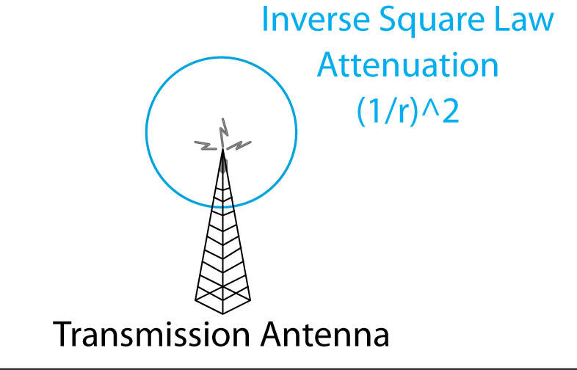
6.5: Wireless Propagation Problems
The signal strength spreads out as the surface of a sphere.
This means that its strength falls as (1/r²), where r is the radius.
If you double the distance, you only get ¼ the signal strength

Slide 13
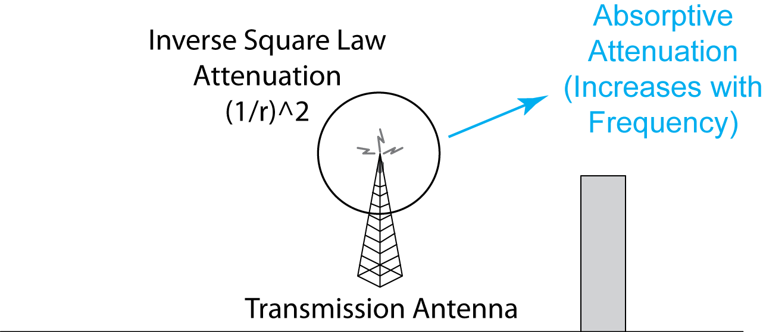
6.5: Wireless Propagation Problems
Signal is absorbed by the air and water.
Note that there are two types of attenuation.
Note that this is different than shadow zones.

Slide 14
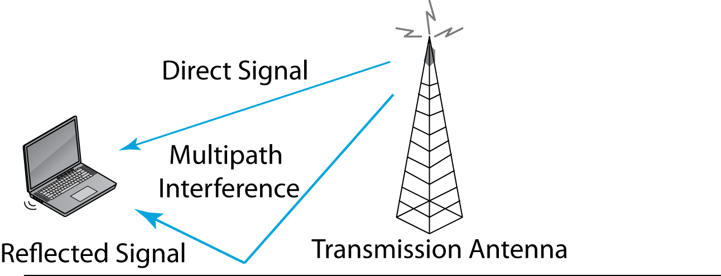
6.5: Wireless Propagation Problems
Direct and reflected signals may interfere.
Most serious propagation problem at WLAN frequencies.

Slide 15
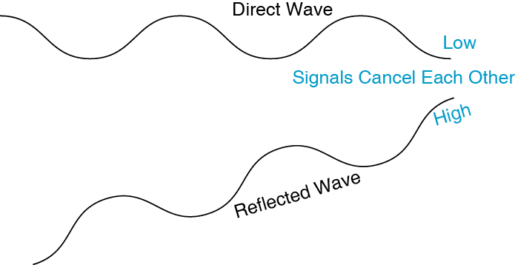
6.6: Multipath Interference
If the two waves are out of phase, they will negate each other, giving no signal.

Slide 16
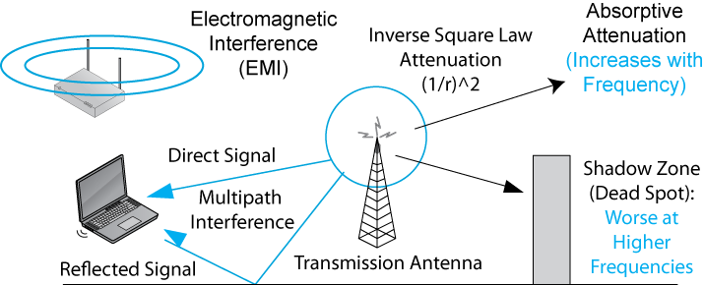
6.5: Wireless Propagation Problems
Recap

Slide 17
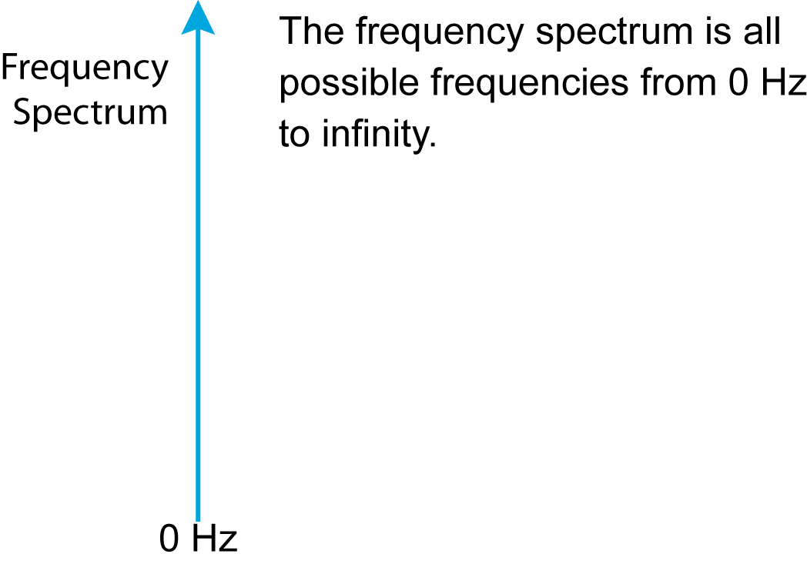
6.7: The Frequency Spectrum, Service Bands, and Channels

Slide 18
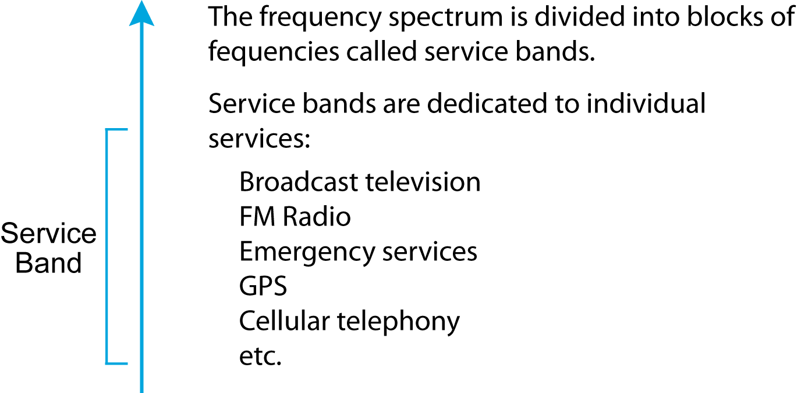
6.7: The Frequency Spectrum, Service Bands, and Channels

Slide 19
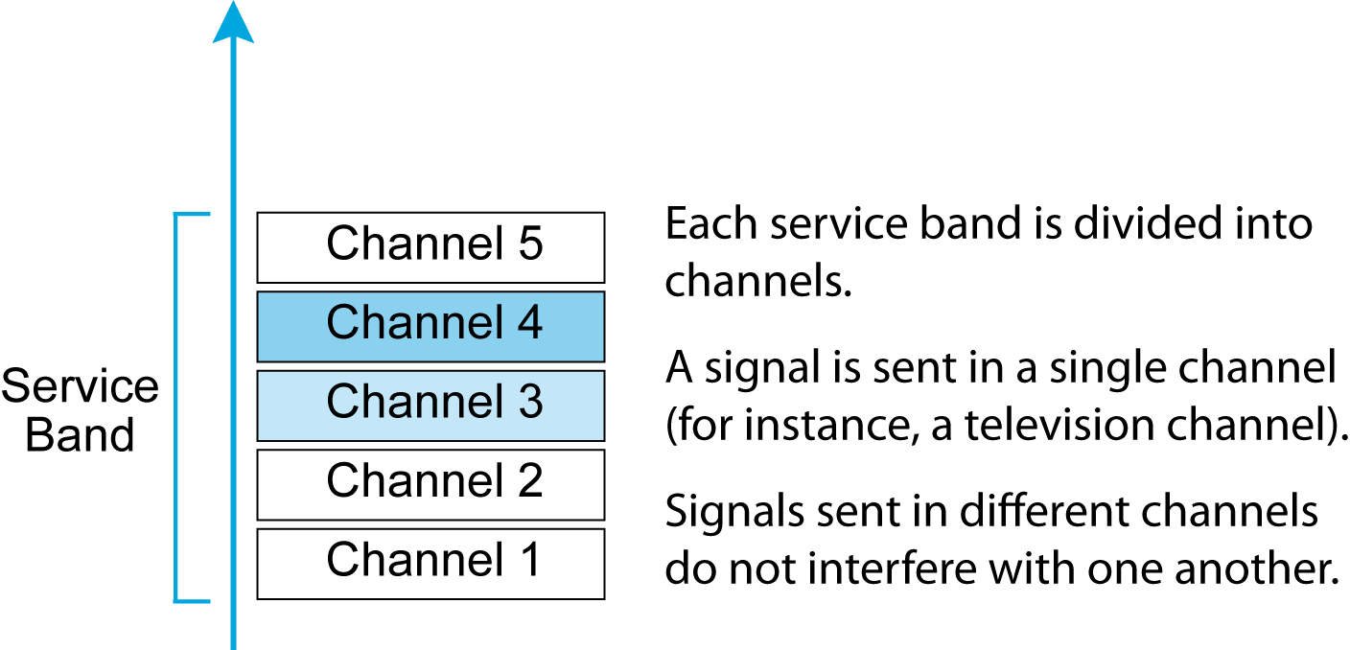
6.7: The Frequency Spectrum, Service Bands, and Channels

Slide 20
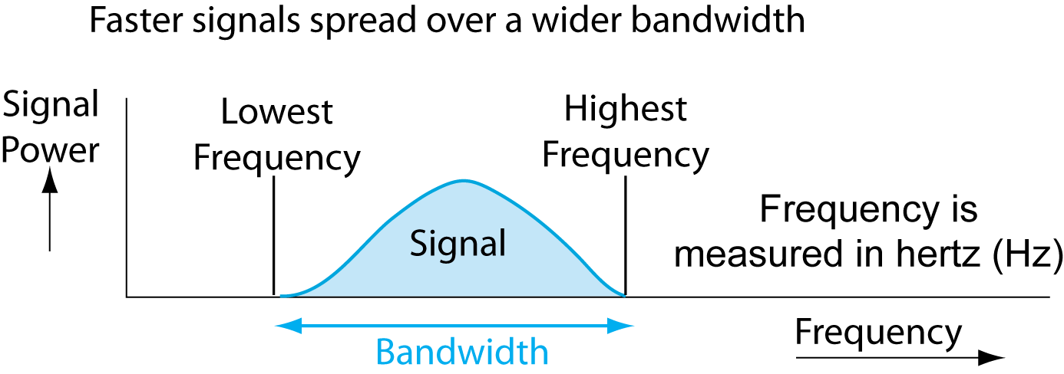
6.9: Channel Bandwidth and Transmission Speed
Signal Bandwidth
Figure 6-2 shows a wave operating at a single frequency.
However, most signals are spread over a range of frequencies (Figure 6-9).

Slide 21
6.8: Channel Bandwidth and Transmission Speed
Channel Bandwidth
Channel bandwidth is the highest frequency in a channel minus the lowest frequency.
An 88.0 MHz to 88.2 MHz channel has a bandwidth of 0.2 MHz (200 kHz).
Higher-speed signals need wider channel bandwidths.

Slide 22
6.8: Channel Bandwidth and Transmission Speed
Broadband and Narrowband Channels
Broadband means wide channel bandwidth and therefore high speed.
Narrowband means narrow channel bandwidth and therefore low speed.
Traditionally, narrowband is below 200 kbps; broadband is above 200 kbps.

Slide 23
6.8: Channel Bandwidth and Transmission Speed
The Golden Zone
Most organizational radio technologies operate in the golden zone in the 500 MHz to 10 GHz range.
Golden zone frequencies are high enough for there to be large total bandwidth.
At higher frequencies, there is more available bandwidth.
Golden zone frequencies are low enough to allow fairly good propagation characteristics.
At lower frequencies, signals propagate better.

Slide 24
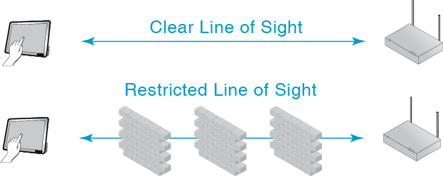
6.10: Line-of-Sight

Slide 25
6.11: Licensed and Unlicensed Radio Bands
Licensed Radio Bands
If two nearby radio hosts transmit in the same channel, their signals will interfere.
Most radio bands are licensed bands, in which hosts need a license to transmit.
The government limits licenses to reduce interference.
Television bands, AM radio bands, and so on are licensed.
In cellular telephone bands, which are licensed, only the central transceivers are licensed, not the mobile phones.

Slide 26
6.11: Licensed and Unlicensed Radio Bands
Unlicensed Radio Bands
Some bands are set aside as unlicensed bands.
Hosts do not need to be licensed to be turned on or moved.
802.11 operates in unlicensed radio bands.
This allows access points and hosts to be moved freely.

Slide 27
6.11: Licensed and Unlicensed Radio Bands
Unlicensed Radio Bands
However, there is no way to stop interference from other nearby users.
Your only recourse is to negotiate with others.
At the same time, you may not cause unreasonable interference—for instance, by transmitting at excessive power.

Slide 28
6.12: 802.11 in the 2.4 GHz and 5 GHz Unlicensed Bands
The 2.4 GHz Unlicensed Band
Defined the same in almost all countries (2.400 GHz to 2.485 GHz)
Commonality reduces radio costs
Propagation characteristics are good

Slide 29
6.12: 802.11 in the 2.4 GHz and 5 GHz Unlicensed Bands
The 2.4 GHz Unlicensed Band
Potential interference from microwave ovens, cordless telephones, and so on
For 20 MHz 802.11 channels, only three nonoverlapping channels are possible
Channels 1, 6, and 11
This creates mutual channel interference between nearby access points transmitting in the same 20 MHz channel

Slide 30
6.12: 802.11 in the 2.4 GHz and 5 GHz Unlicensed Bands
The 5 GHz Unlicensed Band
5 GHz radios are expensive because somewhat different frequency ranges are used in different countries.
Shorter propagation distance than in the 2.4 GHz band because of higher frequencies.
Deader shadow zones than in the 2.4 GHz band because of higher frequencies.

Slide 31
6.12: 802.11 in the 2.4 GHz and 5 GHz Unlicensed Bands
The 5 GHz Unlicensed Band
More total bandwidth than 2.4 GHz, so between 11 and 24 non-overlapping 20 MHz channels.
Allows different access points to operate on non-overlapping channels.
Some access points can operate on two channels to provide faster service.

Slide 32
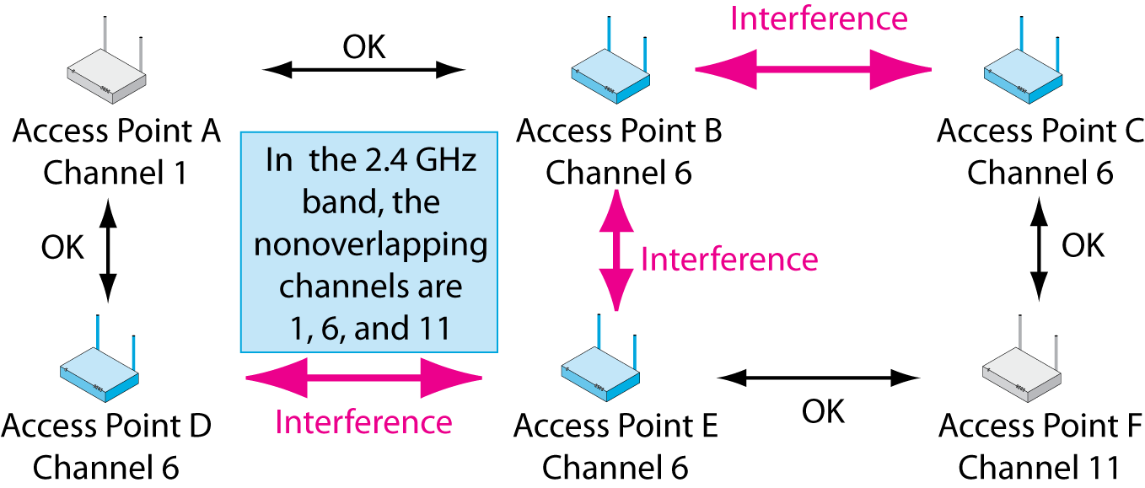
6.13: Co-Channel Interference in 2.4 GHz
The 2.4 GHz Unlicensed Band
Difficult or impossible to put nearby access points on different channels

Slide 33
6.12: 802.11 in the 2.4 GHz and 5 GHz Unlicensed Bands
What is the main advantages of 2.4 GHz operation?
What is the main advantage of 5 GHz operation?

Slide 34
6.14: Spread Spectrum Transmission
Spread Spectrum Transmission
You are required by law to use spread spectrum transmission in unlicensed bands.
Spread spectrum transmission reduces propagation problems.
Especially multipath interference
Spread spectrum transmission is NOT used for security in WLANs.

Slide 35
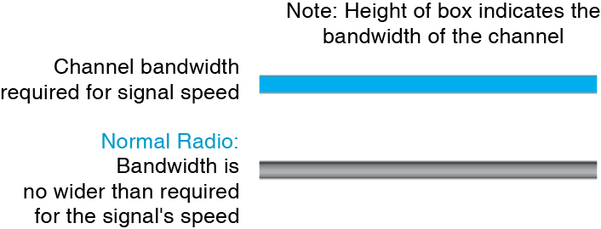
6.15: Normal vs Spread Spectrum Transmission

Slide 36
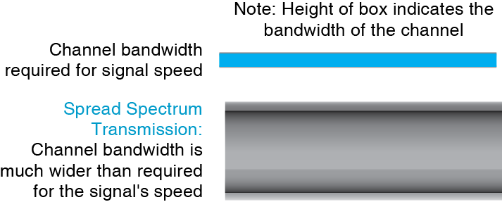
6.15: Normal vs Spread Spectrum Transmission

Slide 37
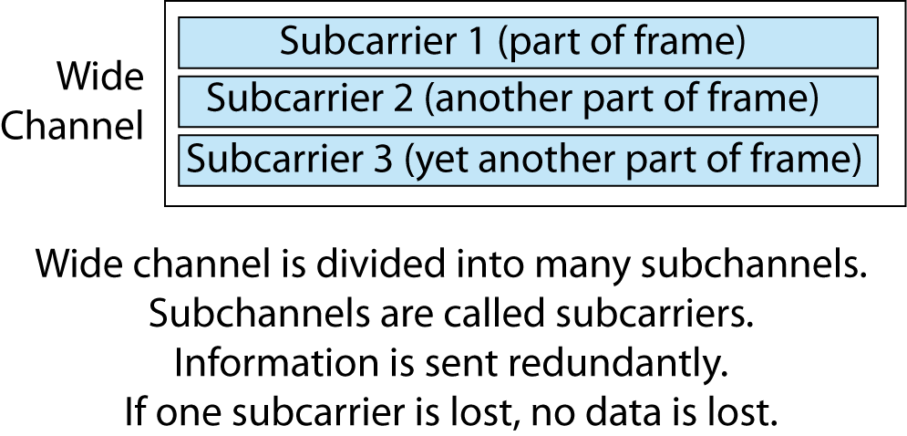
6.16: Orthogonal Frequency Division Multiplexing (OFDM)

Slide 38
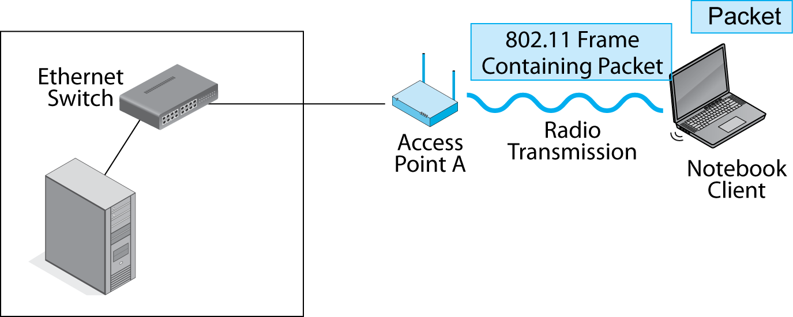
6.17: WLAN Frames and Packets
Sender puts a packet for the destination host into an 802.11 frame, then sends the
frame wirelessly to the access point.

Slide 39
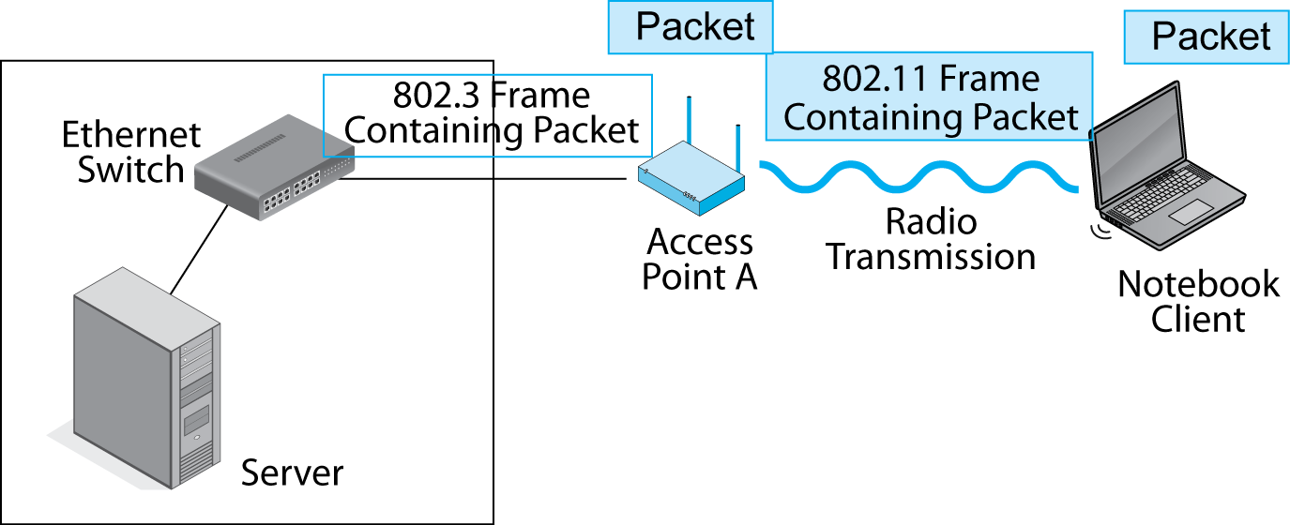
6.17: WLAN Frames and Packets
The 802.11 frame has the wrong frame format to travel over an 802.3 Ethernet network. The switches and destination host would not know what to do with it.
The access point removes the packet from the 802.11 frame and discards the frame.

Slide 40
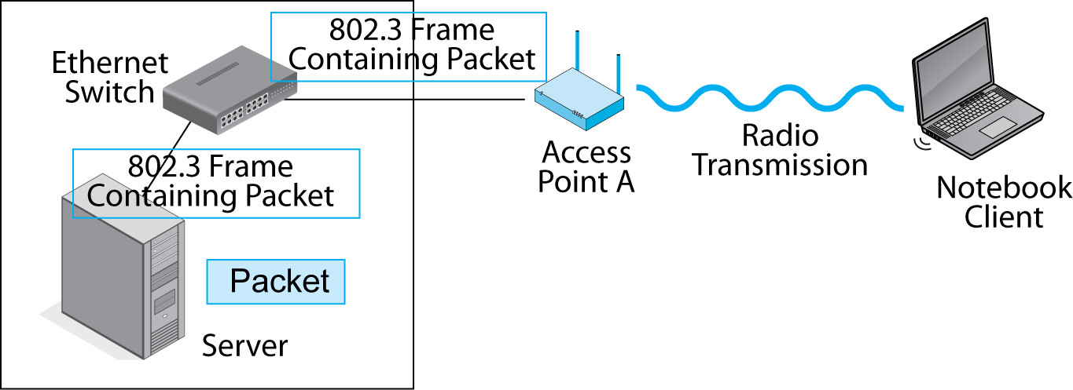
6.17: WLAN Frames and Packets
The access point encapsulates the packet in an 802.3 frame and sends this frame on to the destination host via Ethernet switches.

Slide 41
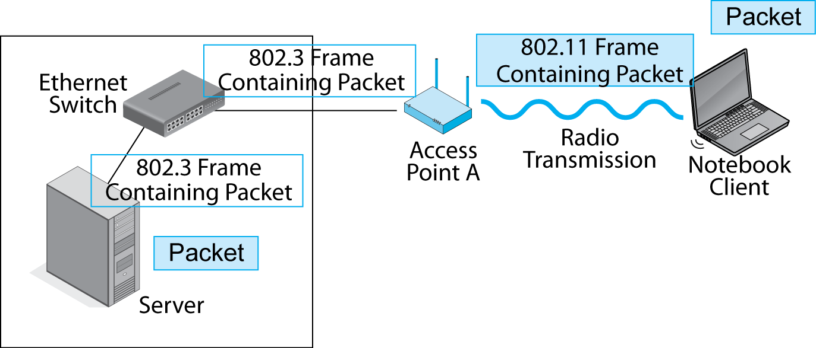
6.17: WLAN Frames and Packets
The Wired Ethernet Network is called the Distribution System
The server removes the packet from the 802.3 frame.

Slide 42
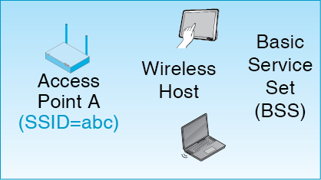
6-18: Basic Service Set (BSS)
An access point and its wireless hosts
Basic Service Set ID (BSSID) is the name of the access point/network

Slide 43
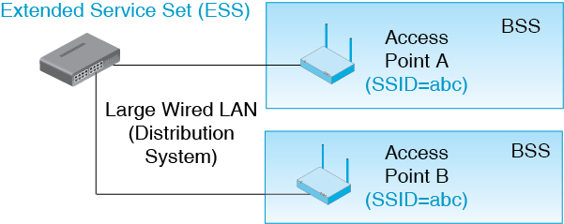
6-18: Extended Service Set (ESS)
Collection of access points that all have the same SSID

Slide 44
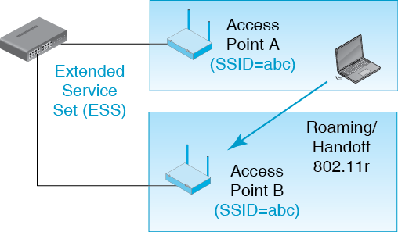
6-18: Roaming
All access points must have the same SSID

Slide 45
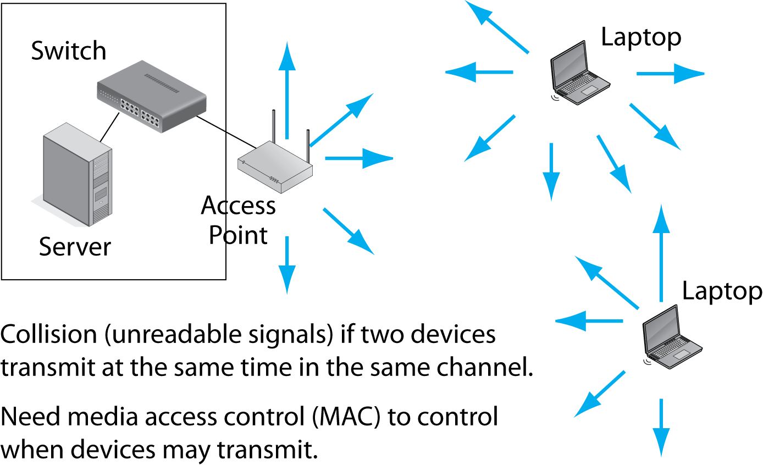
6.19: Transmitting in a Single Channel

Slide 46
6.20: CSMA/CA+ACK
CSMA/CA (Carrier Sense Multiple Access with Collision Avoidance)
Sender listens for traffic
1. If there is traffic, waits

Slide 47
6.20: CSMA/CA+ACK
CSMA/CA (Carrier Sense Multiple Access with Collision Avoidance)
2. If there is no traffic:
2a. If there has been no traffic for less than the critical time value, waits a random amount of time, then returns to Step 1.
2b. If there has been no traffic for more than the critical value for time, sends without waiting.
This avoids collision that would result if hosts could transmit as soon as one host finishes transmitting.

Slide 48
6.20: CSMA/CA+ACK
ACK (Acknowledgement)
Receiver immediately sends back an acknowledgement.
If original sender does not receive the acknowledgement, retransmits using CSMA.
CSMA/CA plus ACK is a reliable protocol.
CSMA/CA+ACK is reliable because wireless transmission has high error rates.
Ethernet has lower error rates and so can be unreliable.

Slide 49
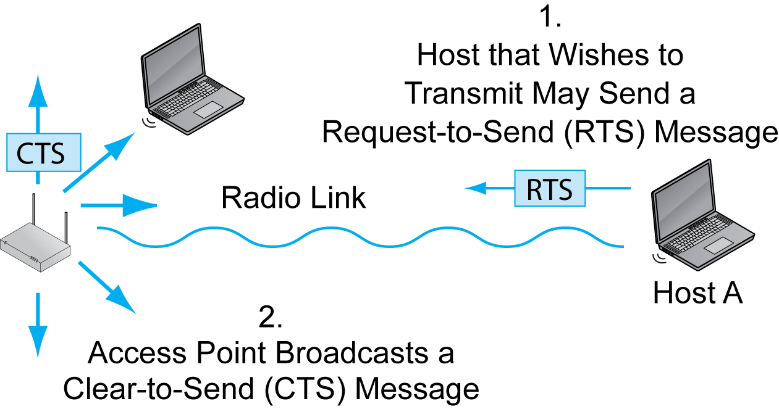
6.21: RTS-CTS

Slide 50
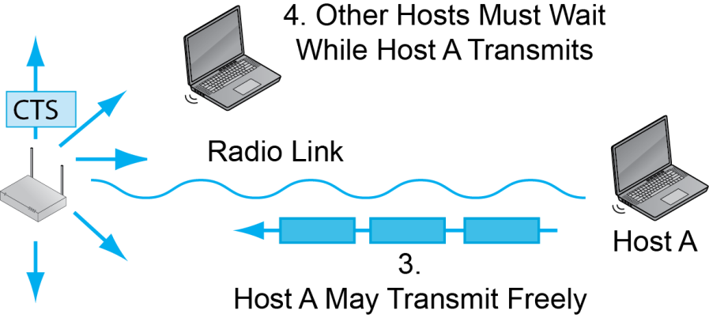
6.21: RTS-CTS
0

Slide 51
Comparison
CSMA/CA is Mandatory
It is the default MAC method.
It is more efficient than RTS/CTS.
RTS/CTS
Is usually optional.
Is good if two or more client stations cannot hear each other.
It will prevent them from transmitting at the same time.

Slide 52
6-22: 802.11 Standards
The 802.11 Working Group has produced several transmission standards.
Existing Standards
802.11g
802.11n
In Development
802.11ac
802.11ad

Slide 53
6.22: 802.11g and 802.11n
Characteristic | 802.11g | 802.11n
Remarks | Today’s dominant 802.11 standard in terms of installed base. | Today’s fastest-growing 802.11 standard. However, not all 802.11n equipment operates in both bands.

Slide 54
6.22: 802.11g and 802.11n
Characteristic | 802.11g | 802.11n
Spread spectrum method | OFDM | OFDM
Unlicensed band | 2.4 GHz | 2.4 GHz. And 5 GHz if dual-band
Channel Bandwidth | 20 MHz | 40 MHz but may drop back if there is interference

Slide 55
6.22: 802.11g and 802.11n
Characteristic | 802.11g | 802.11n
Number of overlapping channels (varies by country) | 3 @ 20 MHz | In the U.S. 2.4 GHz: 3 @ 20 MHz 1 @ 40 MHz 5 GHz: 12 @ 40 MHz

Slide 56
6.22: 802.11g and 802.11n
Characteristic | 802.11g | 802.11n
Rated Speed | 54 Mbps | 100 Mbps to 600 Mbps
Actual throughput, 3 m | 25 Mbps | Closer to the rated speed
Actual throughput, 30 m | 20 Mbps | Closer to the rated speed

Slide 57
6.22: 802.11g and 802.11n
Characteristic | 802.11g | 802.11n
Rated Speed | 54 Mbps | 100 to 600 Mbps 300 Mbps for most equipment
Typical Maximum Distance | 30 m (100 ft) | 70 m (230 ft)

Slide 58
6.22: 802.11g and 802.11n
Characteristic | 802.11g | 802.11n
MIMO? | No | Yes
MIMO is multiple input/multiple output
Allows a sender to transmit two or more signals in the same channel simultaneously
Uses multipath transmission as a benefit instead of a problem

Slide 59
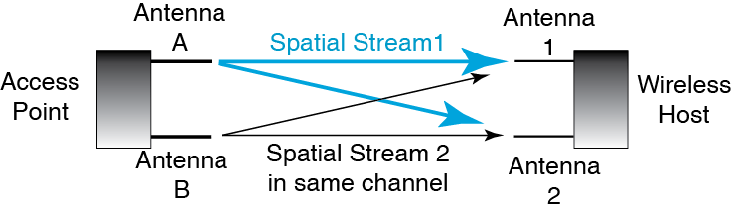
6.23: MIMO
Access point transmits two signals in the same channel—one from Antenna A and
one from Antenna B.
These are called spatial streams.

Slide 60
6.23: MIMO
The two signals arrive at different times at the two receiving antennas. Time differences allow them to be separated and understood.

Slide 61
6.23: MIMO (Multiple Input/Multiple Output)
MIMO Benefits
MIMO brings higher speeds because it can send more information in a channel.
MIMO also brings longer propagation distances for technical reasons we will not discuss.

Slide 62
802.11ac
Standard is under development
Products based on the draft standard are beginning to come to the market
Uses OFDM in the 5 GHz band
Channel bandwidth is 80 MHz or 160 MHz
6 channels at 80 MHz in the United States
3 channels at 160 MHz in the United States

Slide 63
802.11ac
Maximum Number of Spatial Streams
802.11n: 4
802.11ac: 8
However, most products contain fewer antennas and so fewer spatial streams

Slide 64
802.11ac
Rated Speeds
433 Mbps to 6.9 Gbps, depending on channel bandwidth and the number of spatial streams
867 Mbps and 1.3 Gbps will probably be common initially
So called Gigabit 802.11

Slide 65
802.11ad
Gigabit speed but for very short distances
Operates in the 60 GHz band (not 2.4 or 5 GHz)
Channel bandwidth is 2.1 GHz
3 possible channels in the United States, 4 in Europe
Uses MIMO, beamforming and multiuser MIMO (later)
7 Gbps
Replaces in-room cables
Probably not able to work between rooms

Slide 66
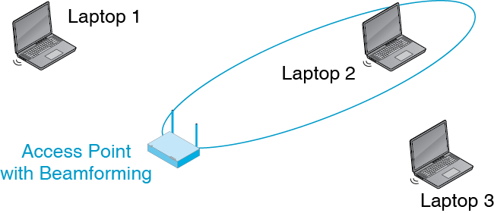
6.24: Beam Forming
Beamforming allows an access point to focus its transmissions and reception

Slide 67
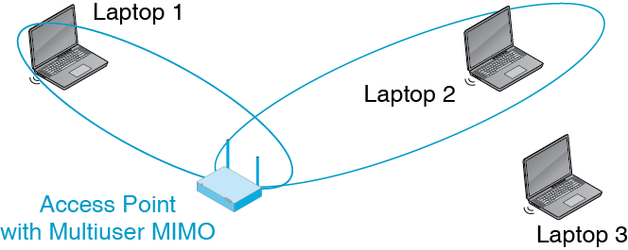
6.24: Beam Forming
Multiuser MIMO allows two wireless hosts to transmit at the same time.

Slide 68
Multiuser MIMO
Defined in 802.11n, but a single method was not defined
Defined in 802.11ac, and there is a single standard, so adoption is more likely

Slide 69
6.25: Speed, Throughput, and Distance
Rated speed versus Throughput
Total throughput is substantially lower than rated speed—sometimes 50% less
In newer 802.11 standards, throughput is closer to the rated speed
Throughput is aggregate throughput shared by all wireless hosts using an access point
But only by the hosts that are actively trying to send and receive at the moment

Slide 70
6.25: Speed, Throughput, and Distance
Throughput versus distance
As distance increases, signals get weaker
Wireless hosts must use slower but more reliable transmission processes
This reduces individual throughput because frames take longer to send

Slide 71
6.25: Speed, Throughput, and Distance
Speed Killers
An 802.11b device connecting to an access point hurts all hosts
Stations far away will transmit more slowly, taking aggregate throughput from other devices

Slide 72
6.26: Trends
White Space Operation
In the United States, broadcasters were required to vacate the UHF spectrum
Some UHF channels have been auctioned off
Unused channels in various bands (called white space) will be made available for unlicensed use
May be used for WLAN operation, but may be reserved for other purposes

Slide 73
6.26: Trends
Impending Spectrum Scarcity
Traffic has been growing explosively
Governments have made many more service bands available
However, traffic may outstrip capacity
This spectrum scarcity will increase prices and may ultimately limit growth

Slide 74
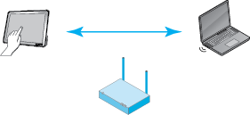
6.27: 802.11 Wi-Fi Direct
Wireless hosts communicate directly, without using an access point.
Standard created by the Wi-Fi Alliance, not by the 802.11 WG

Slide 75
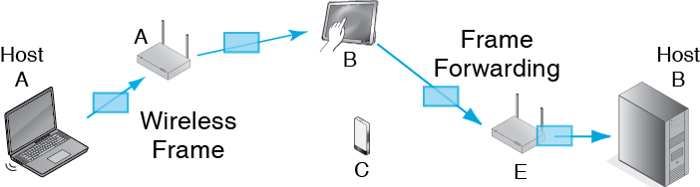
6.28: Wireless Mesh Network
There is no Ethernet network (distribution system)
Frames are forwarded by access points and wireless hosts

Slide 76
6.28: Wireless Mesh Network
Mesh networks are governed by 802.11s
It is not a mature standard

Slide 77


Wireless LANs II
Chapter 7

Slide 78
Where We Are
Chapters 1–4: Introductory Material
Chapter 5: Switched Ethernet LANs
Chapter 6: 802.11 Standards and Operation
Chapter 7: 802.11 Security, 802.11 Management, Other Local Wireless Technologies
Chapters 8–9: TCP/IP Internetworking
Chapter 10: Wide Area Networks
Chapter 11: Applications

Slide 79
802.11 Security
802.11 LAN management
Other local wireless technologies

Slide 80
7.1: WLAN Security Threats
Drive-By Hackers
Sit outside the corporate premises and read network traffic
Can send malicious traffic into the network
Easily done with readily downloadable software
War Drivers
Merely discover unprotected access points—become drive-by hackers only if they break in
War driving per se is not illegal

Slide 81
7.1: WLAN Security Threats
Unprotected Access Points
Drive by hackers can associate with any unprotected access point.
They gain access to the local area network without going through the site firewall.

Slide 82
7.1: WLAN Security Threats
Rogue Access Points
Unauthorized access points that are set up by a department or an individual
Often have very poor security, making drive-by hacking easier
Often operate at high power, attracting many hosts to their low-security service

Slide 83
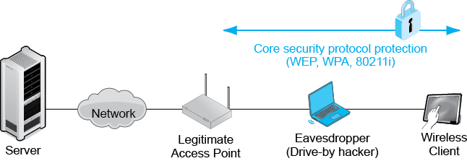
7.2: Core 802.11 Security Standards
Core security protocols protect communication between a wireless client and a legitimate access point.
They provide encryption for confidentiality and other cryptographic protections.

Slide 84
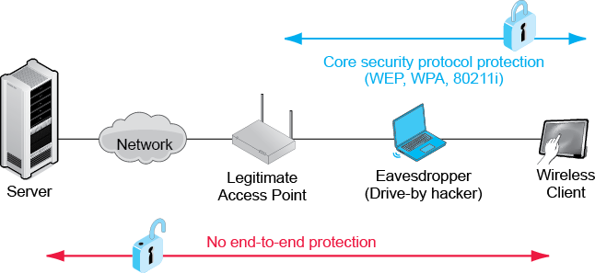
7.2: Core 802.11 Security Standards
802.11 core security protocols protect only wireless client–access point communication.

Slide 85
7.3: 802.11 Core Security Standards
Provide Security Between the Wireless Station and the Wireless Access Point
Client (and perhaps access point) authentication
Encryption of messages for confidentiality

Slide 86
7.3: 802.11 Core Security Standards
Wired Equivalent Privacy (WEP)
Initial rudimentary security provided with 802.11 in 1997.
Everyone shared the same secret encryption key, and this key could not be changed automatically.
Because secret key was shared, it did not seem to be secret.
Users often gave out freely
Key initially could be cracked in 1 to 2 hours; now can be cracked in 3 to 10 minutes using readily available software.

Slide 87
7.3: 802.11 Core Security Standards
Wireless Protected Access (WPA)
The Wi-Fi Alliance
Normally certifies interoperability of 802.11 equipment
Certified equipment may display the Wi-Fi name on their boxes
Created WPA as a stop-gap security standard in 2002 until 802.11i was finished

Slide 88
7.3: 802.11 Core Security Standards
Wireless Protected Access (WPA)
Designed for upgrading old equipment
WPA uses a subset of 802.11i that can run on older wireless NICs and access points.
WPA added simpler security algorithms for functions that could not run on older machines.
Equipment that cannot be upgraded to WPA should be discarded.

Slide 89
7.3: 802.11 Core Security Standards
802.11i (WPA2)
Uses AES-CCMP with 128-bit keys for confidentiality and key management.
802.11i is the gold standard in 802.11 security.
But companies have large installed bases of WPA-configured equipment, so they are hesitant to upgrade.
WPA has now been partially cracked, and this is leading many firms to upgrade.

Slide 90
7.3: 802.11 Core Security Standards
WEP | Initial core security standard. Easily cracked today.
WPA | Has been partially cracked. Large installed base makes upgrading the entire network to 802.11i expensive.
802.11i (WPA2) | Today’s preferred standard. Extremely strong.

Slide 91
7.4: 802.1X and PSK Modes
Both WPA and 802.11i have two modes of operation.
802.1X mode
For large organizations
Uses a central authentication server for consistency
Authentication server also provides key management
Wi-Fi Alliance calls it Enterprise Mode

Slide 92
7.4: 802.1X and PSK Modes
Both WPA and 802.11i have two modes of operation.
802.1X mode
802.1X standard protects communication with an extensible authentication protocol.
Several EAP versions exist with different security protections.
Firm implementing 802.1X must choose one.
Protected EAP (PEAP) is popular because Microsoft favors it.

Slide 93
7.4: 802.1X and PSK Modes
Both WPA and 802.11i have two modes of operation.
Pre-Shared Key mode for homes or small firms
For homes or small businesses with a single access point.
Access point does all authentication and key management.
All users must know an initial pre-shared key (PSK).
Each, however, is later given a unique key.

Slide 94
7.4: 802.1X and PSK Modes
Both WPA and 802.11i have two modes of operation.
Pre-Shared Key mode
If the pre-shared key is weak, it is easily cracked.
Pass phrases that generate keys must be at least 20 characters long.
Wi-Fi Alliance calls this personal mode.

Slide 95

7.4: 802.1X and PSK Modes
 | Can use 802.1X mode? | Can use PSK mode?
WPA | Yes | Yes
802.11i | Yes | Yes
Both WPA and 802.11i use both modes.
This is not surprising because WPA was derived from 802.11i.

Slide 96
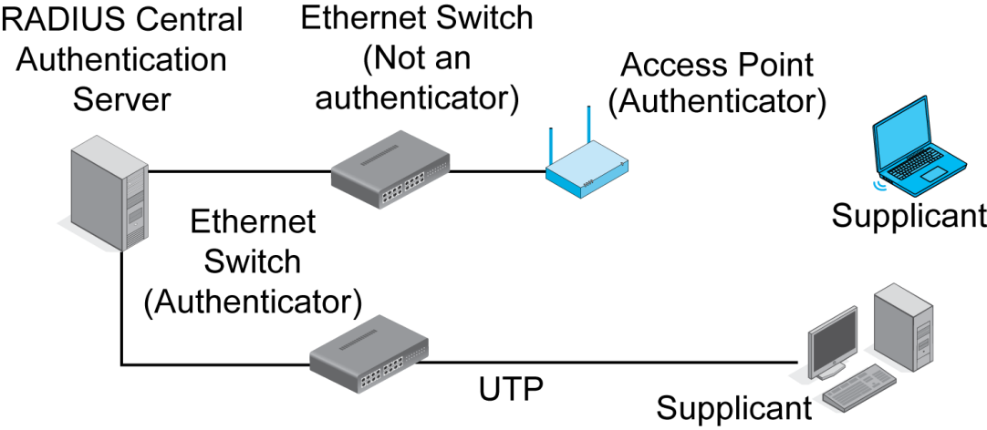
7.5: 802.1X Mode for 802.11i and WPA

Slide 97
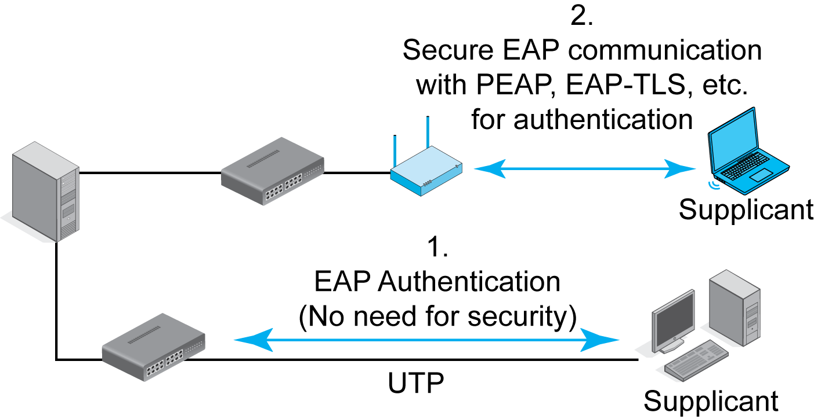
7.5: 802.1X Mode for 802.11i (and WPA)
802.1X Mode (See Figure 7-5)
802.1X in WPA and 802.11i protects client-access point communication with an extensible authentication protocol.
EAP must be protected.
No problem with UTP.
Big problem for wireless.
For wireless, EAP had to be extended.

Slide 98
7.5: 802.1X Mode for 802.11i (and WPA)
802.1X Mode (See Figure 7-5)
802.1X standard protects communication with an extensible authentication protocol.
Several EAP versions exist with different security protections.
Firm implementing 802.1X must choose one.
Protected EAP (PEAP) is popular because Microsoft favors it.

Slide 99
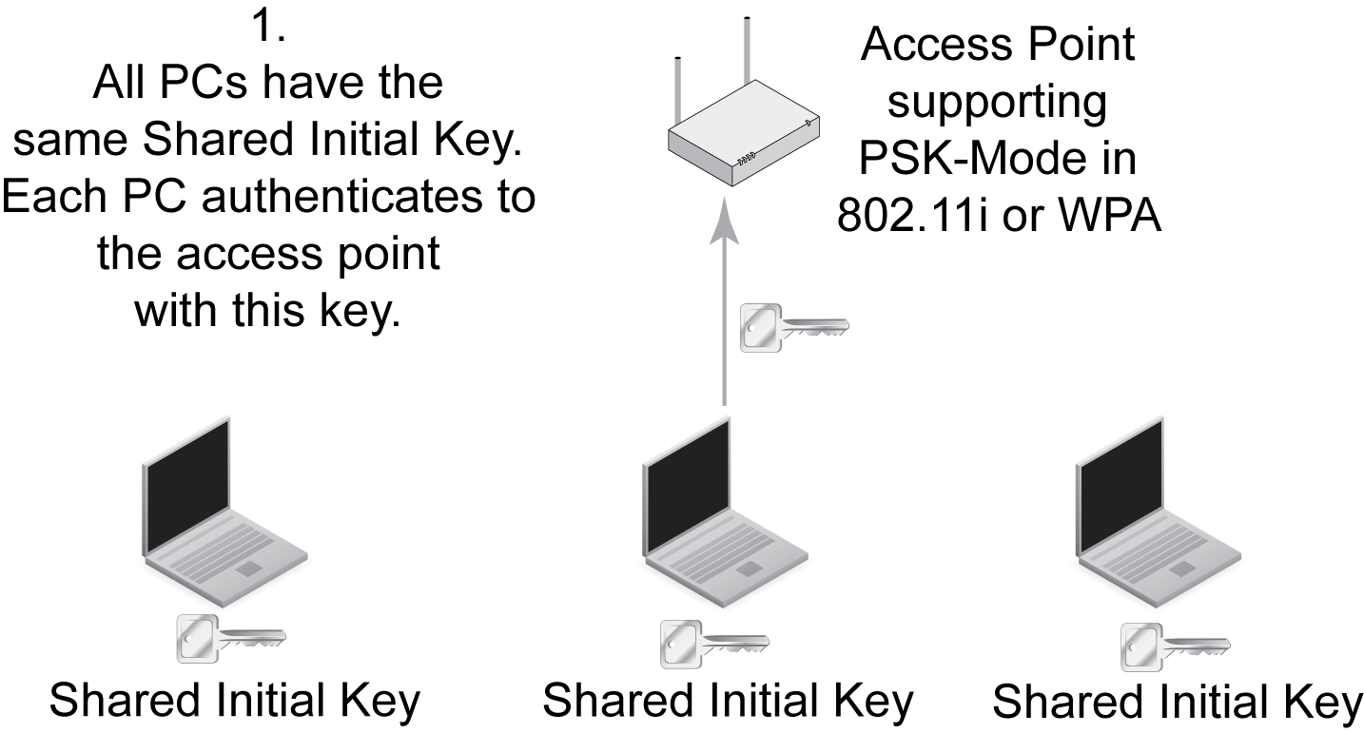
7.6: 802.11i and WPA in Pre-Shared Key Mode

Slide 100
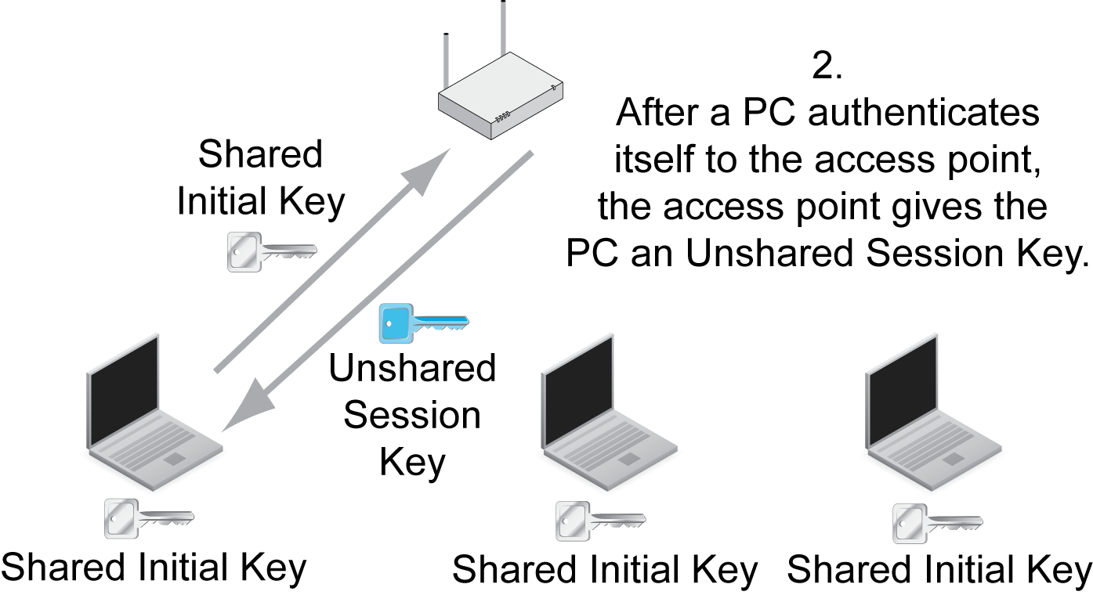
7.6: 802.11i and WPA in Pre-Shared Key Mode

Slide 101
7.6: Shared Keys
WEP
Used the same shared key for everyone.
It was used for a great deal of traffic.
This made the key easy to break.
PSK Mode in 802.11i
Only uses the shared initial key for initial communication, so can’t be cracked.
Only a few people share this key so won’t give it out.
Each host then gets a different shared session key.
Too little traffic is sent with this key to be cracked.

Slide 102
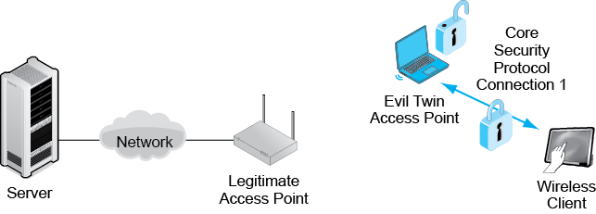
7.7: Evil Twin Access Point
Sits outside the premises or in a wireless hot spot
A PC with software to emulate an access point
Entices the wireless client to associate with it

Slide 103
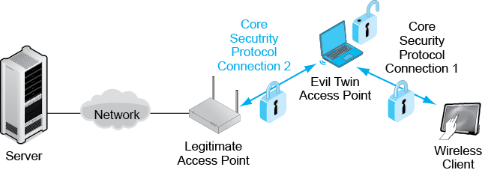
7.7: Evil Twin Access Point
Establishes a second connection with a legitimate access point
All traffic between the wireless client and network servers passes through the evil twin.

Slide 104
7.7: Evil Twin Access Point
This is a classic man-in-the-middle attack.
Attacks on confidentiality because evil twin reads all traffic.
Client encrypts traffic.
Evil twin decrypts it and reads it.
Evil twin reencrypts it and sends it on.
Evil twin can also send attack packets, which do not pass through the border firewall.

Slide 105
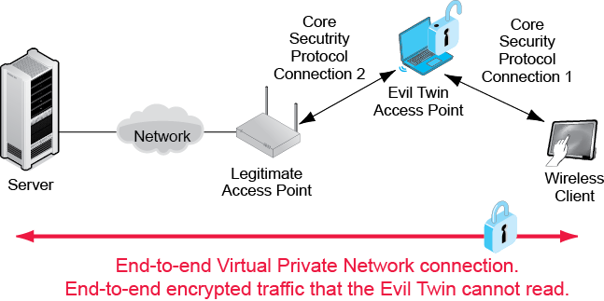
7.8: Using a VPN to Counter Evil Twins
Virtual Private Networks (VPNs)
End-to-end encryption with a pre-shared client-server secret
The secret is never transmitted so cannot be intercepted.

Slide 106
Wi-Fi Protected Setup
Usually just called WPS
Protocol to make it easier to connect clients to access points
Very popular
Created by the Wi-Fi Alliance, not the 802 Committee

Slide 107
Wi-Fi Protected Setup
Designed poorly
Pre-shared keys can be cracked in about 5,500 attempts
Easy to do with automated attacks
Only solution is to turn off WPS at the router
Many routers cannot even turn it off
A problem for PSK but not 802.1X

Slide 108
Denial-of-Service (DoS) Attacks
Either overloads the access point with traffic
Or sends a command to get a client to disassociate from an access point
Uncommon but dangerous

Slide 109
802.11 Security
802.11 LAN management
Other local wireless technologies

Slide 110
7.9: WLAN Management
Access Points Placement in a Building
Must be done carefully for good coverage and to minimize interference between access points.
Lay out 30-meter to 50-meter radius circles on blueprints.
Adjust for obvious potential problems such as brick walls.
In multistory buildings, must consider interference in three dimensions.

Slide 111
7.9: WLAN Management
Access Points Placement in a Building
Install access points and do site surveys to determine signal quality.
Adjust placement and signal strength as needed.
In commercial access points, signal strength and other configuration information can be actively controlled.

Slide 112
7.9: WLAN Management
Remote Access Point Management
The manual labor to manage many access points can be very high.
They must be managed efficiently through automation.

Slide 113
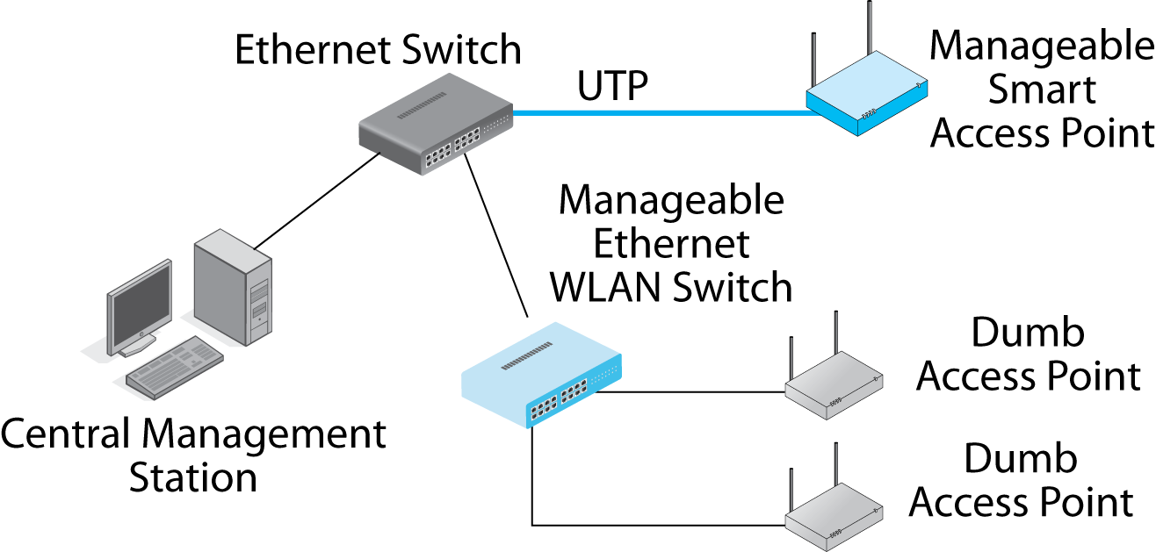
7.10: Wireless Access Point Management Alternatives

Slide 114
7.9: WLAN Management
Remote Access Point Management
Desired networking functionality:
Notify the WLAN administrators of failures immediately.
Support remote access point adjustment.
Should provide continuous transmission quality monitoring.
Allow software updates to be pushed out to all access points or WLAN switches.
Work automatically whenever possible.

Slide 115
7.9: WLAN Management
Remote Access Point Management
Desired security functionality:
Notify administrator of rogue access points.
Notify administrator of evil twin access points.
Notify the administrator of flooding denial-of-service attacks.
Notify the administrator of disassociate message denial-of-service attacks.
Instantly deny access to selected stations under selected conditions.

Slide 116
802.11 Security
802.11 LAN management
Other local wireless technologies

Slide 117
7.21 Security in Emerging Wireless Technologies
Threats
Eavesdropping
Data modification
Impersonation
Denial-of-service attacks

Slide 118
7.21 Security in Emerging Wireless Technologies
Cryptological Security
Some local wireless technologies have no cryptological security.
Example: Near field communication for reading passive ID tags.
They rely on short transmission distances to foil eavesdroppers.
Directional antennas and amplifiers can defeat this.

Slide 119
7.21 Security in Emerging Wireless Technologies
Strength of Security
Some have reasonably good security.
Example: Bluetooth
However, still not as strong as 802.11i and WPA security.

Slide 120
7.21 Security in Emerging Wireless Technologies
Device Loss or Theft
In this age of bring your own device (BYOD) to work, this is a serious problem.
Most devices are protected only by short PINs.

Slide 121
7.21 Security in Emerging Wireless Technologies
Maturity
In general, new security technologies take some time to mature.
During this period, they often have vulnerabilities that must be fixed quickly.
User companies must master security for each new technology.

Slide 122
Where We’ve Been
802.11 Security
802.11 LAN management
Other local wireless technologies

Slide 123
Where We’re Going
Chapter 5 dealt with single wired switched networks.
Chapters 6 and 7 dealt with single wireless networks.
Single networks operate at Layers 1 and 2 and so use OSI standards
Chapters 8 and 9 deal with internets at Layers 3 and 4, where the IETF’s TCP/IP standards dominate.

